Slide 1

DHOLE PATIL COLLEGE OF ENGINEERING,PUNE
DEPARTMENT OF COMPUTER ENGINEERING
Presentation On
HealthCare Chatbot
Presented By –
Supriya Bankar
Shivani Deshmukh
Kishor Gadhave
Nilesh Jadhav
Guided By -
Prof. Vikas More

Slide 2
Table of contents
Introduction
Literature Survey
Problem Statement
Scope
System Architecture
Usecase Diagram
Features
Advantages & Disadvantages
Applications
Conclusion
References

Slide 3
Introduction
In this presentation, we propose a chatbot system capable of diagnosing diseases based on symptoms reported by users .
Issues such as geographical constraints, long wait times for appointments, and limited healthcare resources often prevent individuals from receiving timely medical advice and assistance.
The system utilizes machine learning algorithms to analyze symptoms and provide accurate diagnoses and recommendations.
The healthcare chatbot project seeks to harness the power of ML-driven conversational interfaces to provide accessible, personalized, and timely healthcare support.

Slide 4
Problem Statement
People living in remote places or rural areas have limited access to healthcare facilities.
It is difficult to have access to hospital and doctors personally on regular basis.
It is time consuming and costly to approach hospitals for normal consultancy.

Slide 5
Literature Survey
Sr.no | Name of Paper | Year of paper Published | Author | Summary
1. | Using machine learning for Electronic Health Records | 2021 | Lekha Athota Student, Bachelor of Science Information Technology Amity University, Dubai, UAE lekhaA@amitydubai.ae | This chatbot aims to make a conversation between human and machine. Here the system stores the knowledge database to identify the sentence and making a decision to answer the question.
2. | HealthCare chatbot using machine learning | 2022 | Prof. Vasudha Phaltankar1, Vishal Sharma2, Akshad Shah3, Sahib Singh4, Sulabh Mehra | The chatbots are conversational virtual assistants which automate interactions with the users

Slide 6
Scope
The scope of the chatbot can evolve over time based on user feedback, technological advancements, and changes in healthcare needs.
Symptoms recognition using x-ray.
It can offer emotional support, stress management techniques, and resources for mental health and well-being.
Automatized robot(Interact with people like Doctor)

Slide 7


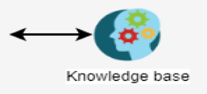

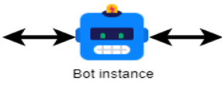


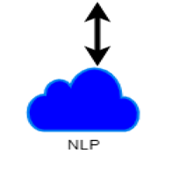
System Architecture

Slide 8
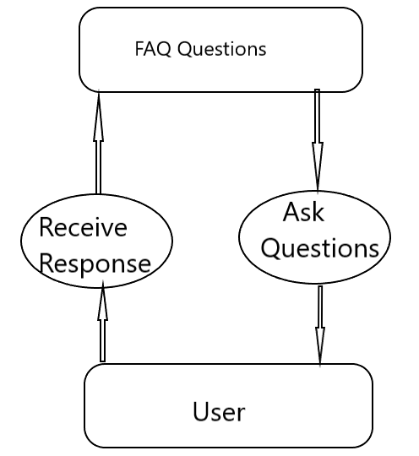
Use case diagram

Slide 9
Features
It has a simple syntax and is easy to learn, making it accessible for developers of all skill levels.
Python's versatility allows for the integration of other technologies, such as machine learning algorithms, to enhance chatbot capabilities.
Python offers a wide range of libraries and frameworks, such as NLTK and Tensor Flow, for natural language processing.

Slide 10
Advantages
24/7 Accessibility: provide round-clock accsess.
Cost-effective Healthcare:By automating routine tasks and providing self-service options, chatbots help streamline healthcare delivery processes.
Scalability and Accessibility:Chatbots can scale to accommodate a large number of users simultaneously.
Continual Learning and Improvement: Chatbots can leverage machine learning algorithms to continuously learn from user interactions and refine their responses over time.
Prompt Responses: Chatbots offer immediate responses to user queries, reducing wait times for information and assistance.

Slide 11
Disadvantages
Lack of Human Interaction: Chatbots lack the empathy, emotional intelligence, and nuanced understanding that human healthcare providers offer.
Risk of Misdiagnosis: In cases where chatbots provide medical advice or diagnoses, there is a risk of misdiagnosis or overlooking critical symptoms.
Technical Limitations and Errors: Chatbots are susceptible to technical failures, bugs, and errors that can disrupt user interactions and compromise the user experience.
Training and Maintenance Costs: Developing and maintaining sophisticated healthcare chatbots require significant investments in technology infrastructure, software development, and ongoing support.

Slide 12
Applications
This application can be used in hospitals, in cities.
This application can also be used for medical consults for detecting the stress on a social interaction of social network.
This application could be used by peoples with disabilities.
This application can also be used for the exploration of the development, implementation, and potential impact of the healthcare chatbot.

Slide 13
Conclusion
It is concluded that , the usage of Chatbot is user friendly and can be used be any person who knows how to type in their own language in their own device.
A medical chatbot provides personalized diagnoses based on symptom.
The system's accuracy and robustness highlight its potential for use in real-world healthcare settings.
Future work may involve enhancing the chatbot's capabilities, integrating additional features, and expanding the dataset.

Slide 14
References
https://medicalfuturist.com/top-10-health-chatbots/
https://www.leadsquared.com/industries/healthcare/healthcare-chatbot/
https://www.ibm.com/products/watsonx-assistant/healthcare
https://yellow.ai/blog/healthcare-chatbot/
https://www.irjet.net/archives/V9/i2/IRJET-V9I2193

Slide 15
ThankYou

